Slide 1
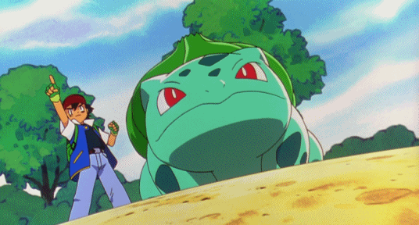
What can you do?
I can use vine whip!

Slide 2
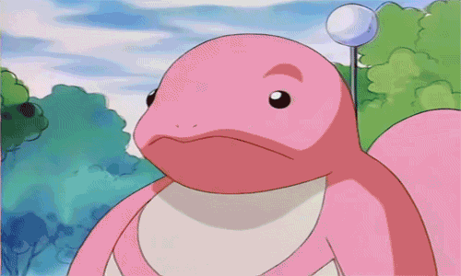
Let’s learn more and be Lickitung to read aloud!
I can …?

Slide 3
fly
cook

Slide 4
jump
draw

Slide 5
swim
read

Slide 6
sing
write

Slide 7
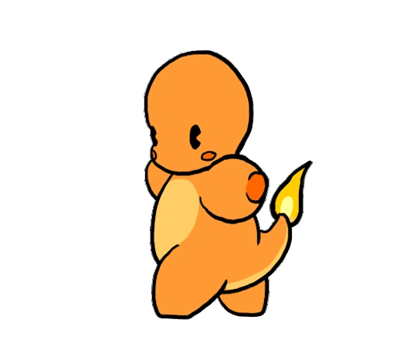
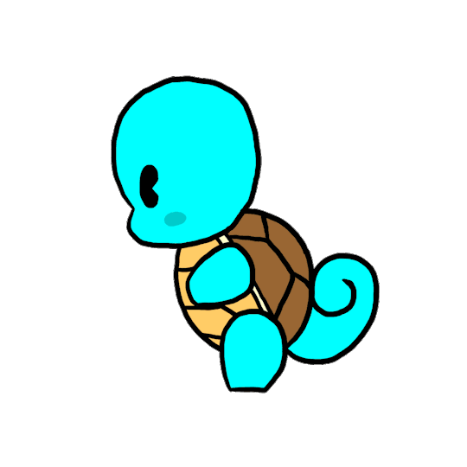
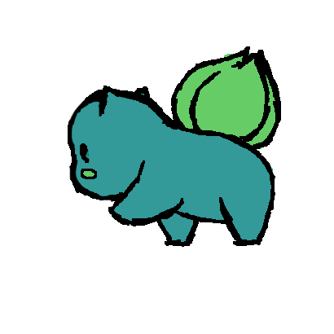
walk

Slide 8
swim
run

Slide 9
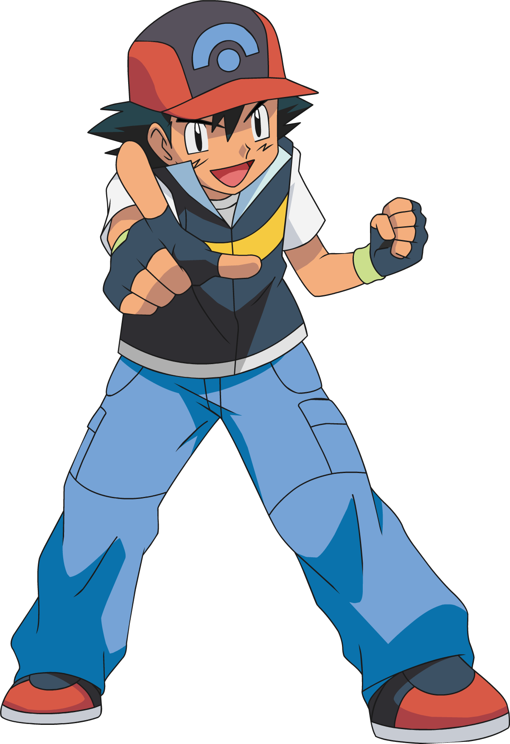
Get a whiteboard.
Listen carefully and write down the word.

Slide 10
cook

Slide 11
read

Slide 12
draw

Slide 13
run

Slide 14
write

Slide 15
walk

Slide 16
fly
It can cook.

Slide 17
jump
I can draw.

Slide 18
swim
He can read.

Slide 19
sing
I can write.

Slide 20
swim
She can run.

Slide 21
They can walk.

Slide 22
What can you do?
I can draw.

Slide 23
What can he do?
He can cook.

Slide 24
What can she do?
She can read.

Slide 25
What can it do?
It can walk.

Slide 26
What can they do?
They can run.

Slide 27
What can Harry Potter do?
He can write.

Slide 28
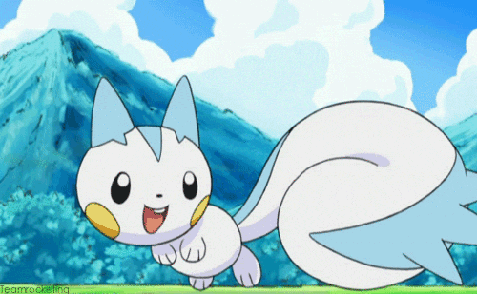
Good job!
Let’s turn to page 22 and listen to the story.

Slide 29
What can Dino do?
Dino can’t ______.
Owen can’t ______.

Slide 33
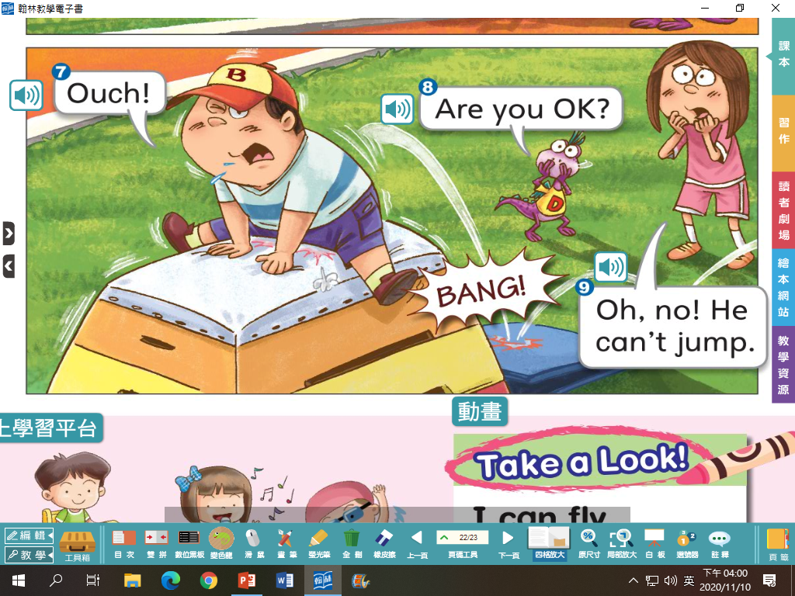

Slide 35
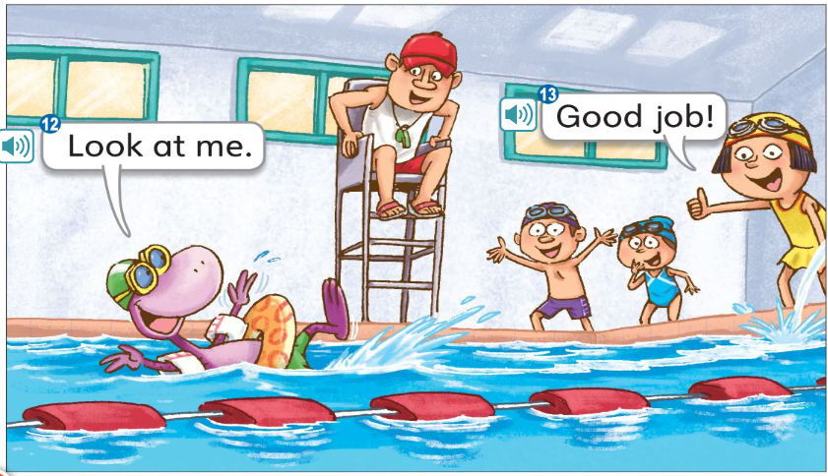

Slide 37
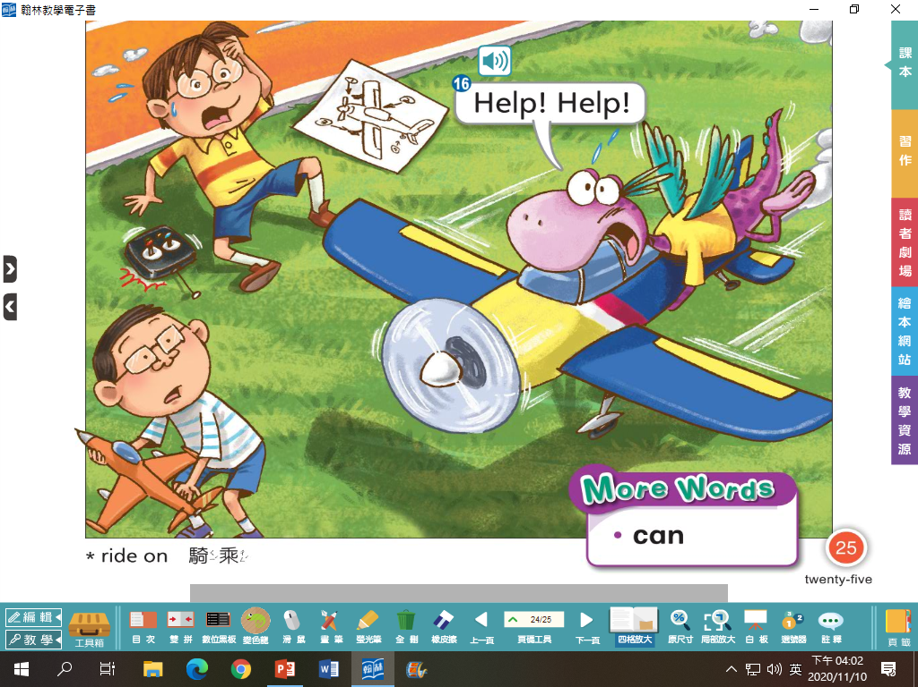

Slide 38
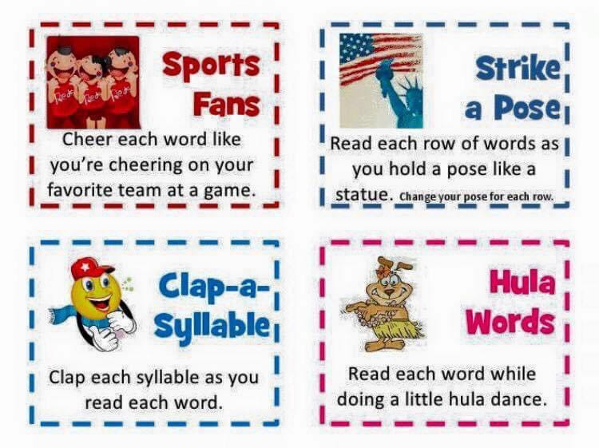

Slide 39
Homework this week
聽: CD1第26-31首。
說&讀:聽CD時跟著大聲唸。完成3遍
請家長在課本P19簽名可換印章。
寫: 完成英語習作P45-46，下週一交。
背: Unit 1單字，下週進行隨堂小考。

Slide 40
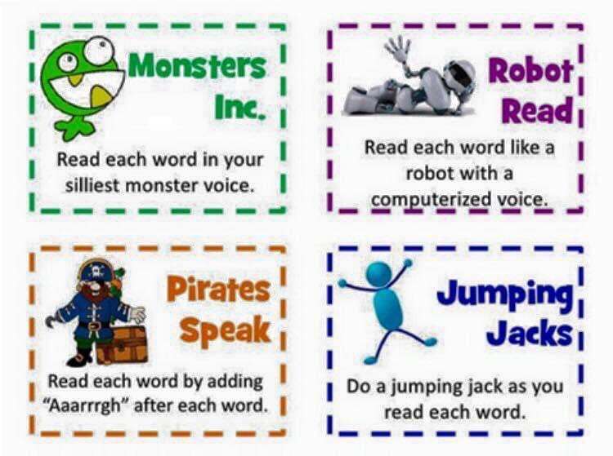

Slide 41
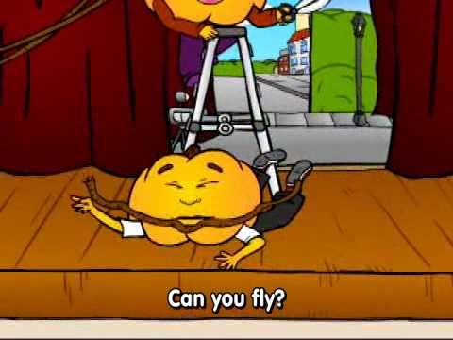
Pumpkin Cartoon

Slide 42
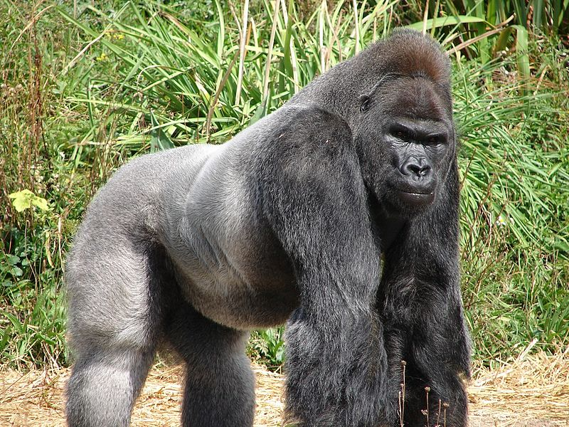
From Head to Toe By Eric Carle

Slide 43
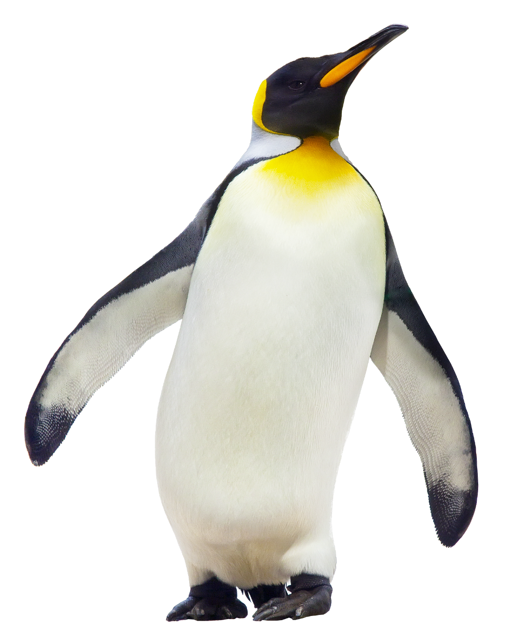
I am a penguin.
And I can turn my head.
Can you do it?
I can do it!

Slide 44
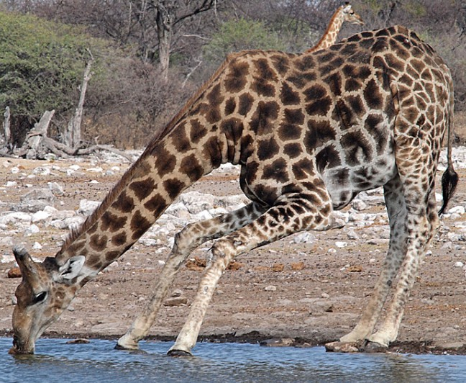
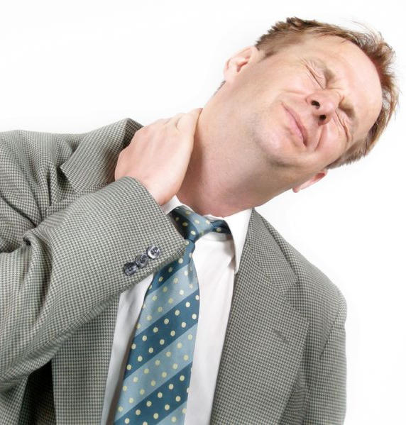
I am a giraffe.
And I can bend my neck.
Can you do it?
I can do it!

Slide 45
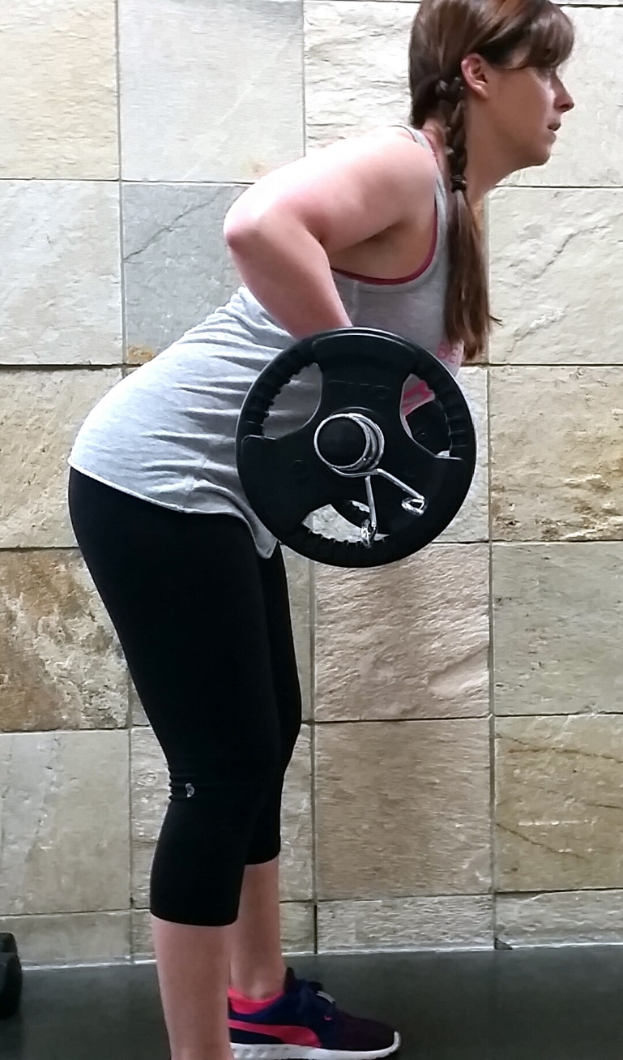
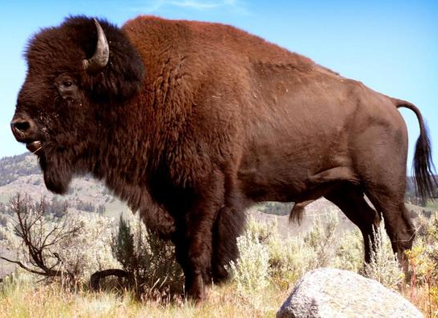
I am a buffalo.
And I can raise my shoulders.
Can you do it?
I can do it!

Slide 46
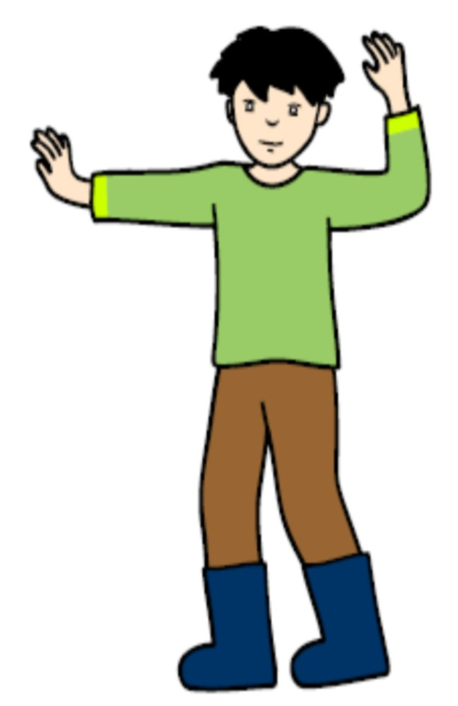
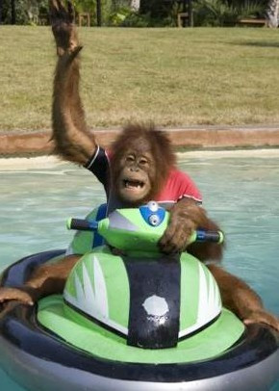
I am a monkey.
And I can wave my arms.
Can you do it?
I can do it!

Slide 47
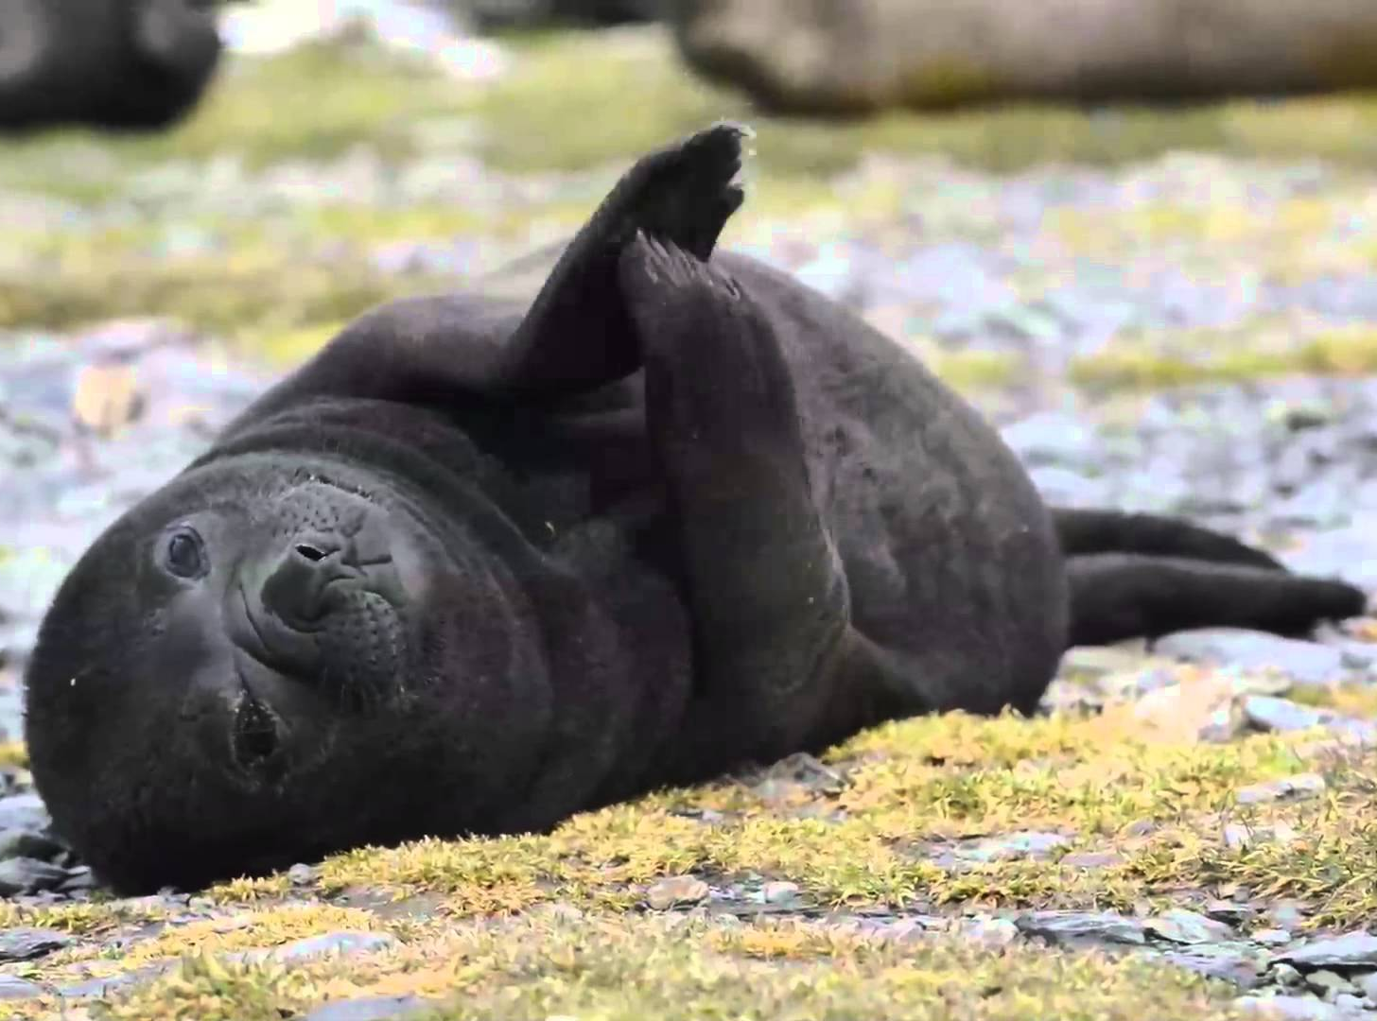
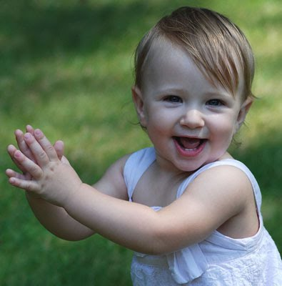
I am a seal.
And I can clap my hands.
Can you do it?
I can do it!

Slide 48
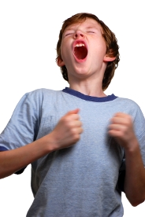
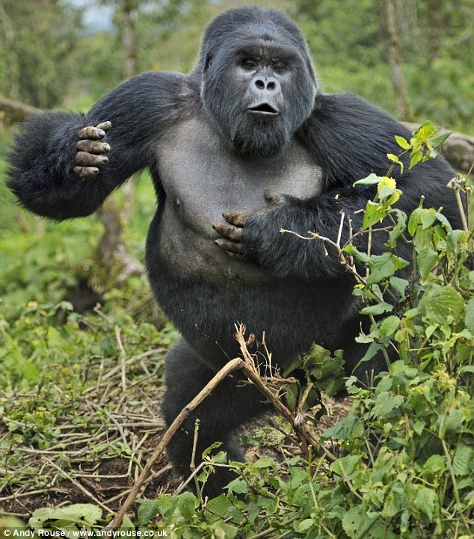
I am a gorilla.
And I can thump my chest.
Can you do it?
I can do it!

Slide 49
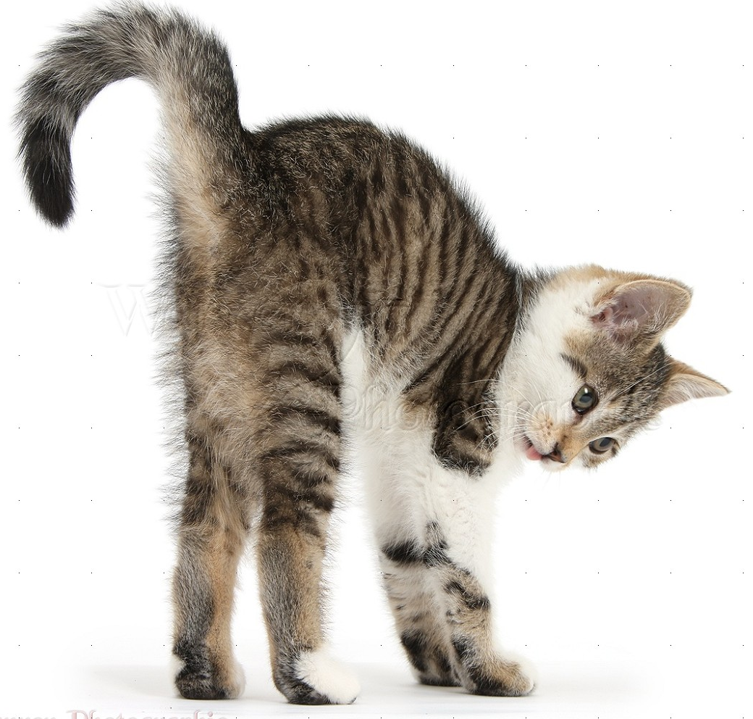
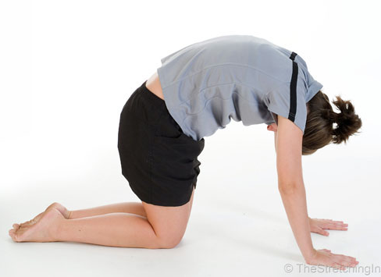
I am a cat.
And I can arch my back.
Can you do it?
I can do it!

Slide 50
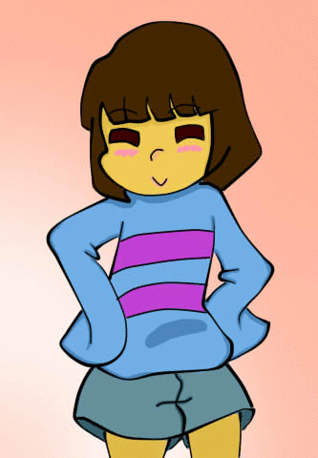
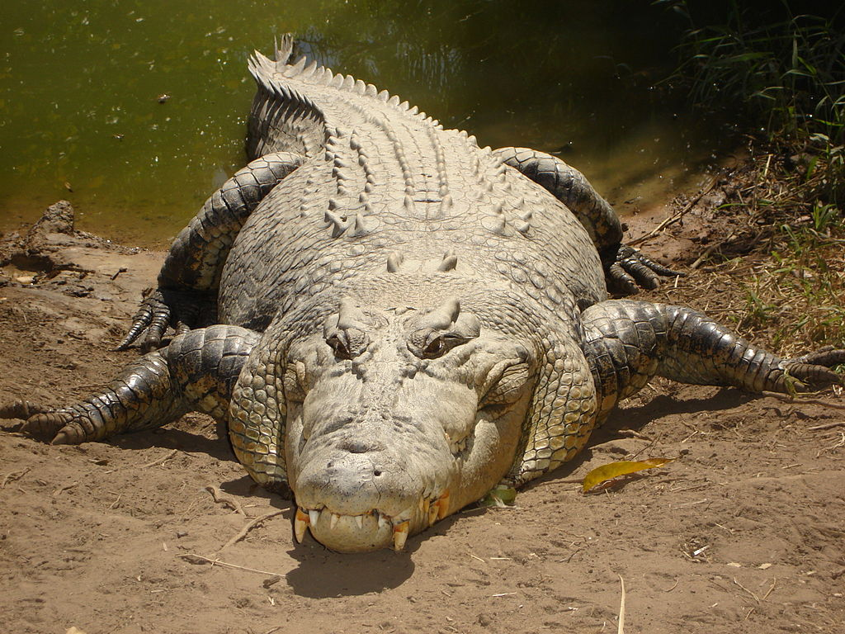
I am a crocodile.
And I can wriggle my hips.
Can you do it?
I can do it!

Slide 51
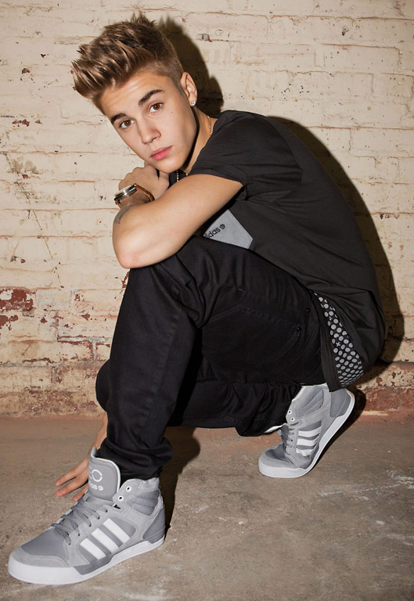
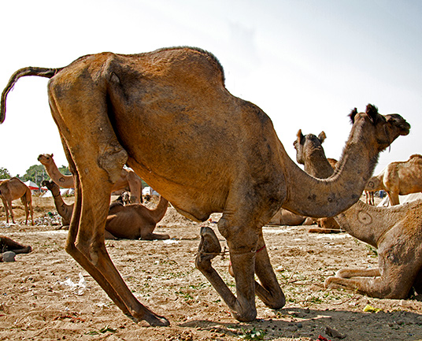
I am a camel.
And I can bend my knees.
Can you do it?
I can do it!

Slide 52
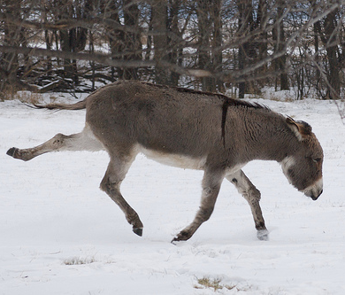
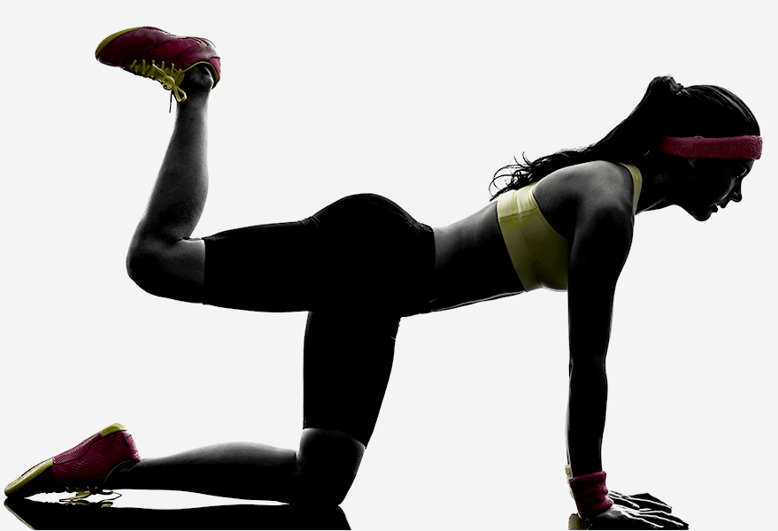
I am a donkey.
And I can kick my legs.
Can you do it?
I can do it!

Slide 53
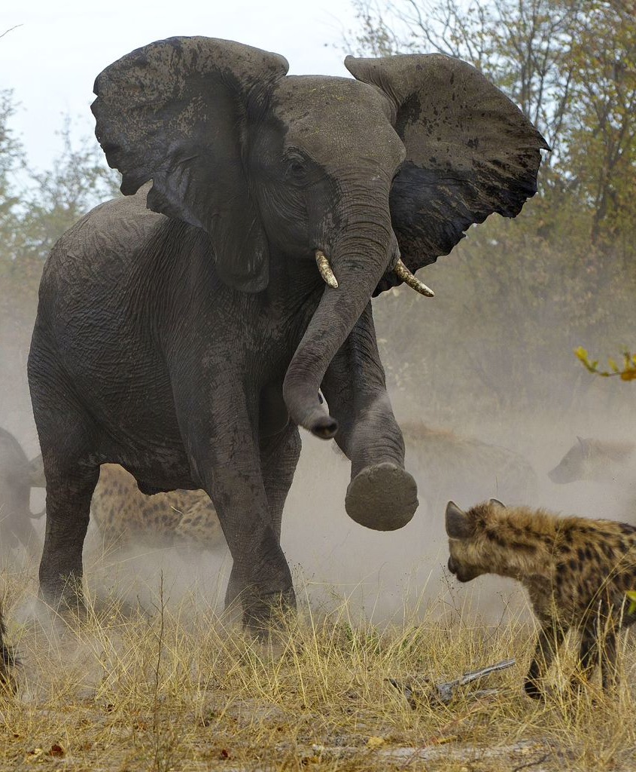
I am an elephant
And I can stomp my foot.
Can you do it?
I can do it!

Slide 54
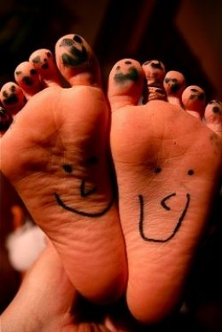
I am I
And I can wiggle my toes.
Can you do it?
I can do it!
I can do it!

